Slide 1
2020 Presidential Election
Democratic Caucus Improvements and
Hybrid Primary-Caucus Proposals

Slide 2
Objective
Improve Access, Ensure Confidence
Build the Party, Win Elections Large & Small
The threat to our democracy doesn't just come from Donald Trump.
The biggest threat to our democracy is indifference. …"
-Barack Obama

Slide 3
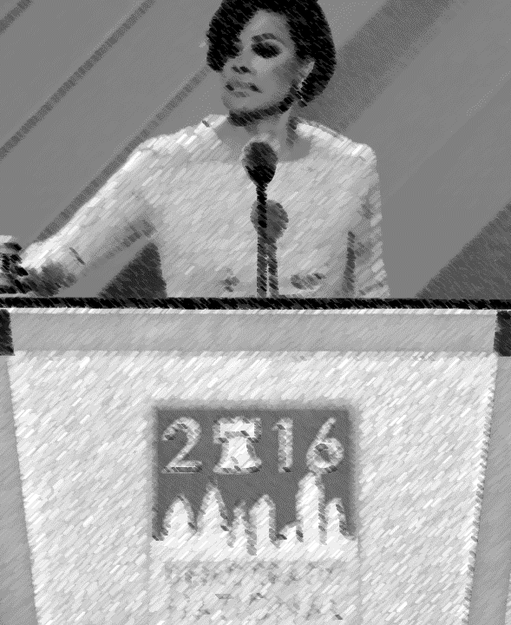
Caucus Cycle
Delegate Allotment Determined at Precinct Caucuses
  Discuss & Advocate for Candidates
Delegates Elected at Each Stage to Represent
Electoral College Elected at State Convention
How It Currently Works
Precinct Caucus
Elect LD Delegates
Legislative District Caucus
Elect CD and State Convention Delegates
Congressional District Caucus
Elect Delegates to the National Convention
State Convention
Party Platform
Resolutions
Votes on Changes to Party Structure/Rules
Elect At-Large National Delegates and Electoral College Elector
Grassroots
First Impressions
Energy & Passion
Citizen Engagement
Opportunity to Discuss
Volunteer Recruitment
Fundraising
Party Building
Requires Planning and Volunteers!
Campaigning
Speeches
Further Engagement with Voters
Party Building
Inspiring Stories and People
Speeches
Elect CD Electoral College Elector

Slide 4
Historic Attendance
Compared to 2008:
111,000 more people voted in primary
16,000 less people voted in the caucus
In 2008, 2.8x more primary voters
In 2012, 3.5x more primary voters

Slide 5
Lessons Learned
The primary and caucus results aren't always in agreement
Caucus attendance was lower than 2008. Even so, state party estimates used to select venues were much lower than actual turn outs, resulting in overcrowding
Waiting to reserve a venue until the last minute resulted in limited choices and higher costs.
Venue sizing should be done with a comfortable margin for attendance
Absentee voting was limited to specific conditions (sickness, work, military service) now everyone has an absentee option.
Lack of volunteers and poor planning/venue selection can lead to chaos

Slide 6
Estimates
 | Improved Caucus | Hybrid Primary Caucus | Improved Caucus Breakeven
Est Attendees (Precinct/LD) | 4800 | 400 | 4800
Fundraising (8% donate $10) | $3840 | $320 | $480 (1%)
New Member Dues | $3350 | $500 | $1920
Venue(s) & Supplies | - $2400 | - $1400 | - $2400
TOTAL Revenue | $4790 | - $580 | 0
PCO Recruitment (0.8%) | 38 | 12 | 30 (0.6%)
Membership Drive (2%) | 96 | 8 | 47 (<1%)
Only as good as the effort we put in!
There are no good estimates for Hybrid Caucus attendance. Highly depends on results.

Slide 7
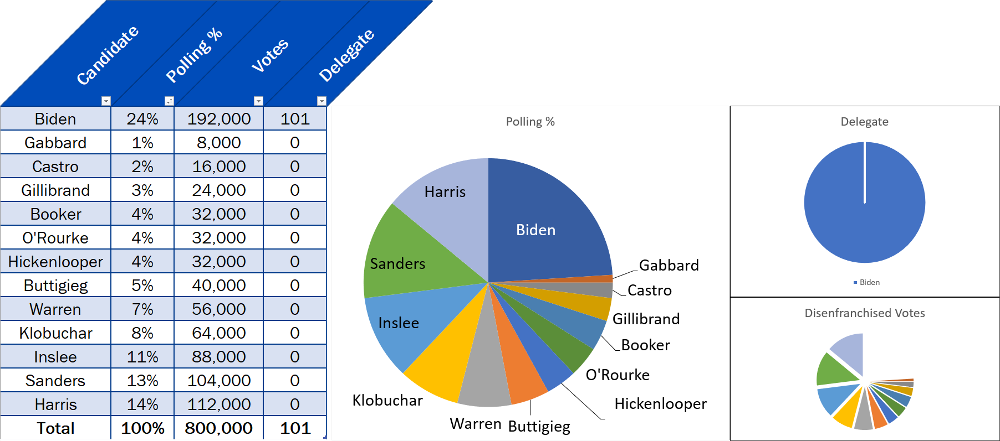
15% Support Threshold
To be allotted any delegates, a candidate must have at least 15% of the vote.

Slide 8
Caucus Pros and Cons
Pros
Cons
Expanded absentee balloting will result in increased and easier participation
Slightly decreased turnout reduces volunteer burden
Rules allow delegates to reallocate their vote once to prevent "vote spoilage"
Biggest opportunity for party building
Data collected remains within the party
Large fundraising opportunity - 2016: $3k
Early planning already started
Barometer of grassroots candidate support
PCO Recruiting Central
Requires a large amount of planning and volunteers
Venues must be accommodating to those with special needs who do not wish to use absentee voting
Time commitment
Cost of investment
Can become chaotic without proper planning

Slide 9
Primary Pros and Cons
Pros
Cons
Larger voting opportunity
Requires very little effort
Cost saving
No party registration
Precinct level data loss
Republican access to voting data
Big money and disinformation campaign influence in primaries
Greatly decreased party building opportunity
Loss of fundraising opportunity
Loss of party volunteer & PCO recruiting
With many candidates in race, supporters of minority candidates with no delegates unlikely to get involved
15% threshold - DNC Rule and the potential for wide scale vote spoilage

Slide 10

THANK YOU!
21st Legislative District Democrats

